Slide 1


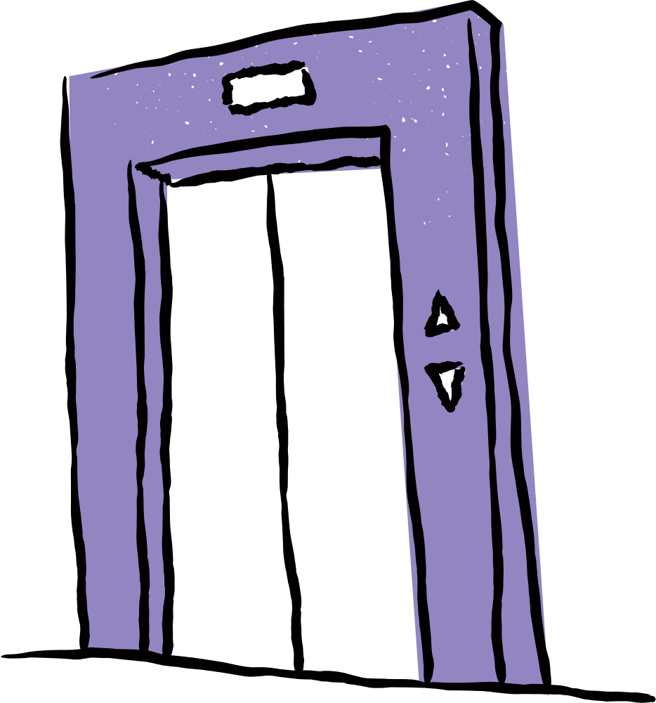
Final Project
Design and Implementation of a 3-Stage Elevator System Using HCS12 Microcontroller
Instructor: Mrs. Shaza Khatib
Fall 2025
Group Members:
Nour El Mais
Elissa Saad
Omar Shehab
Edward Mouawad

Slide 2


Introduction
The goal of this project is to build a 3-floor elevator system using the HCS12 microcontroller that detects floor requests issued through the push buttons, and moves accordingly, while displaying text on the LCD, and blinking the corresponding LEDs and buzzer.
Moreover, it implements weight-based safety using the the potentiometer.

Slide 3
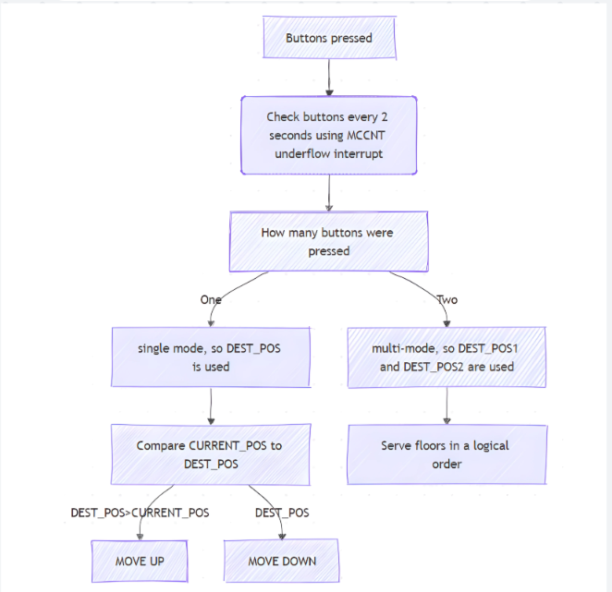
How does it work?

Slide 4
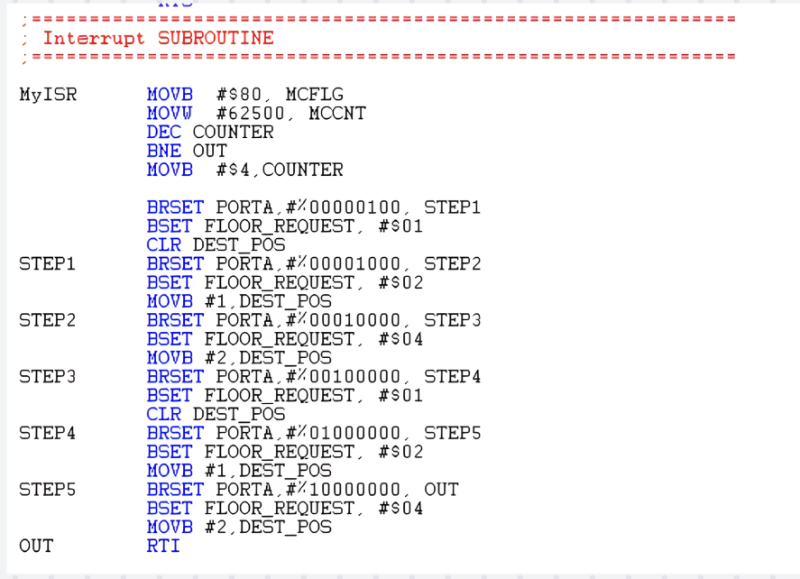


Button Reading inside MCCNT

Slide 5
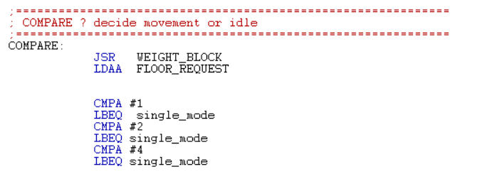
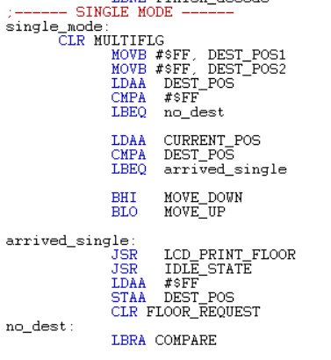


Comparison Logic (1)
Case 1: Single mode (a single button was pressed)

Slide 6
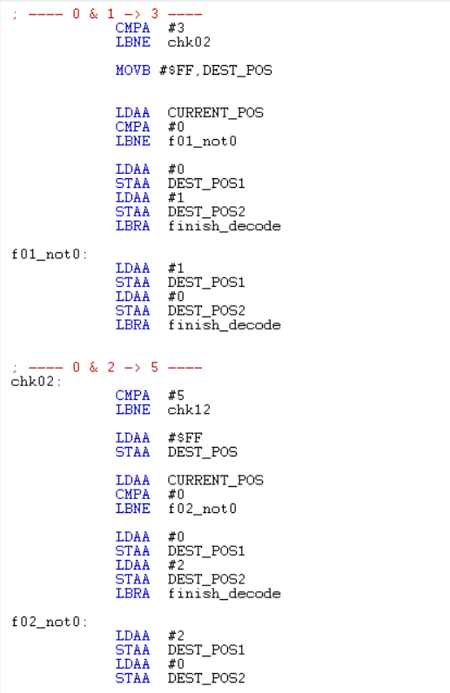
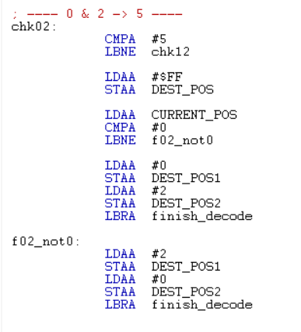
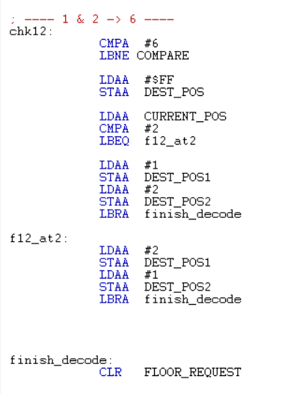
Comparison Logic (2)
Case 2: Multi mode (two buttons were pressed)

Slide 7
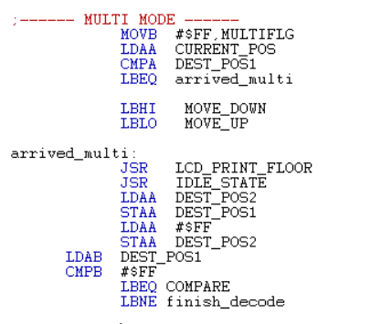
Comparison Logic (3)
Case 2: Multi mode (two buttons were pressed)

Slide 8
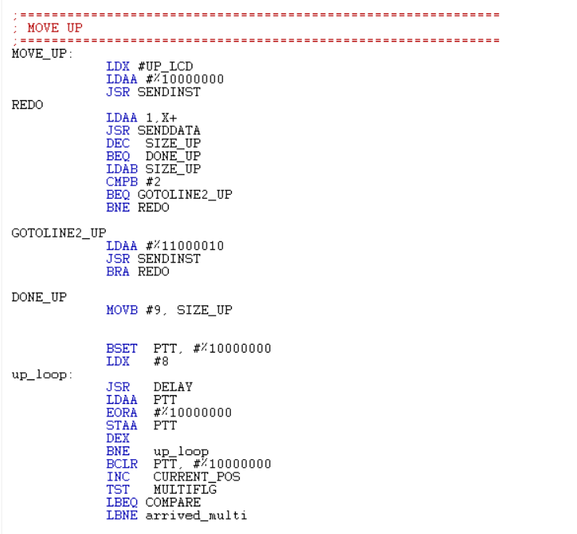
Moving UP

Slide 9
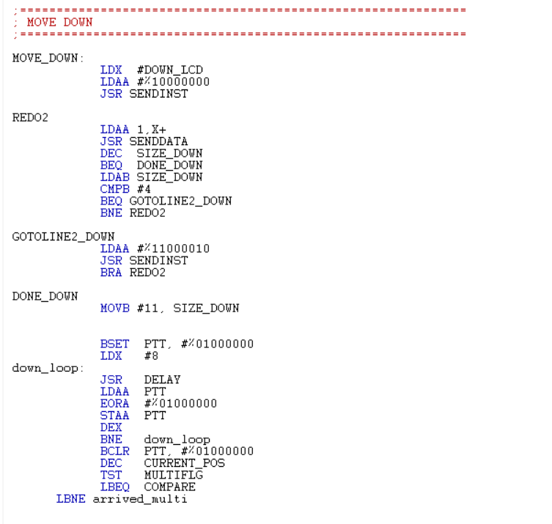
Moving DOWN

Slide 10
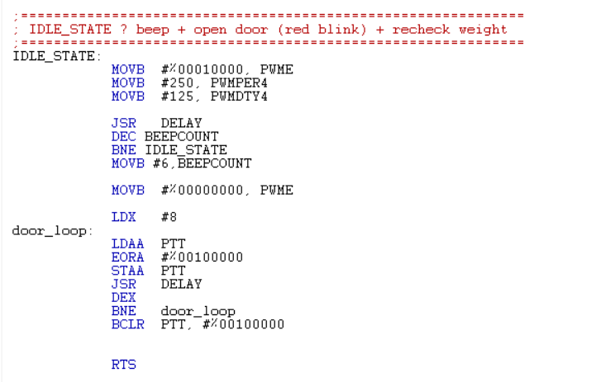
IDLE state

Slide 11
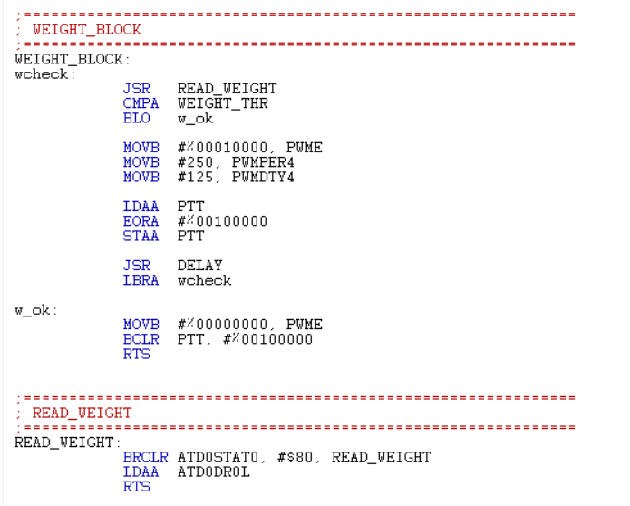
Weight Checking
1- Read value of the potentiometer
2- Compare this value to the threshold value

Slide 12
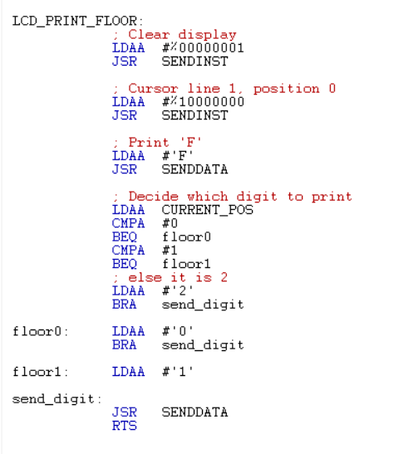
LCD
This code writes the corresponding floor number on the LCD when it reaches the destination floor

Slide 13
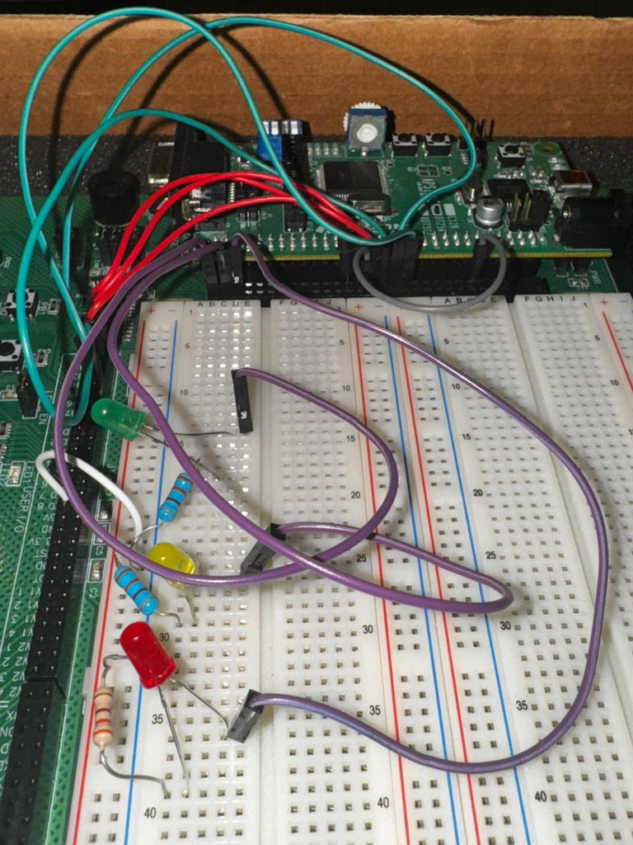
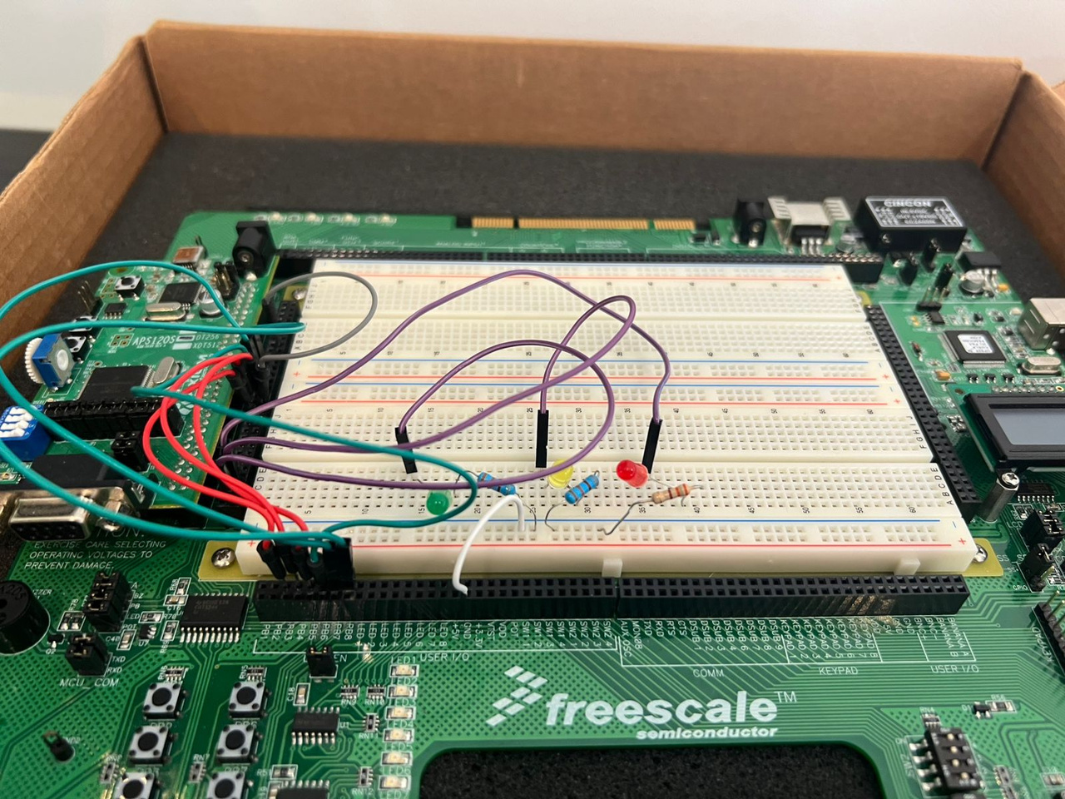

Slide 14



Thank You !

